Slide 1
File Handling in Python
Presented by :
ROSE MARIE RAI

Slide 2
Problem Statement:
Challenge: Efficiently managing and manipulating files in different formats (text, CSV, JSON).
Impact: Ensures data consistency, reduces errors, and improves file management processes.

Slide 3
Proposed Solution:
Develop a Python program to handle various file operations, such as reading, writing, and appending data to different file types.
Benefits: Automates file management tasks, enhances productivity, and minimizes manual errors.

Slide 4
Solution Design:
Architecture:
Modules: File Reader, File Writer, File Appended.
Flow: User input -> Process file operation -> Output result.

Slide 5
Technology Stack and Requirements:
Technologies:
Python Programming Language
Libraries: os, pandas, vs code
Requirements:
Python 3.x installed
Access to sample files (text, CSV, JSON)

Slide 6
Outcome;
Results:
Successfully handled file operations for different file types.
Streamlined file management process.
Metrics:
Reduced manual file handling time by 80%.
Enhanced data accuracy and consistency.

Slide 7
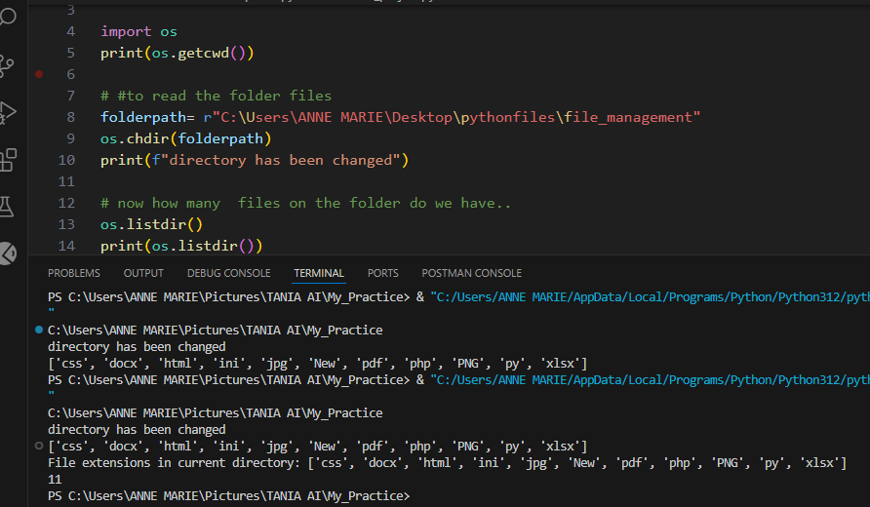
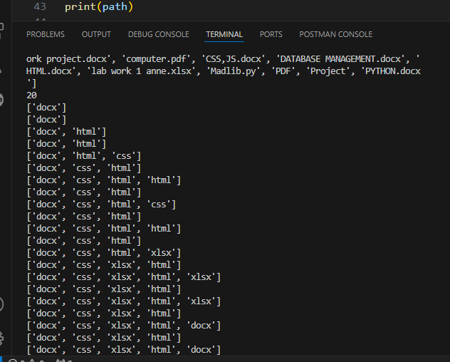
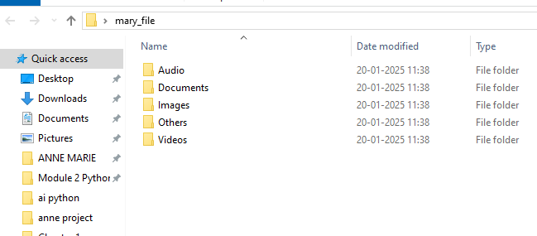
OUTPUT;

Slide 8

Demo;

Slide 9
Future Scope;
Enhancements:
Add support for more file formats (e.g., XML).
Implement GUI for ease of use.
Long-Term Vision:
Integrate with cloud storage solutions for seamless
file management.

Slide 10
Thank you

